Slide 1
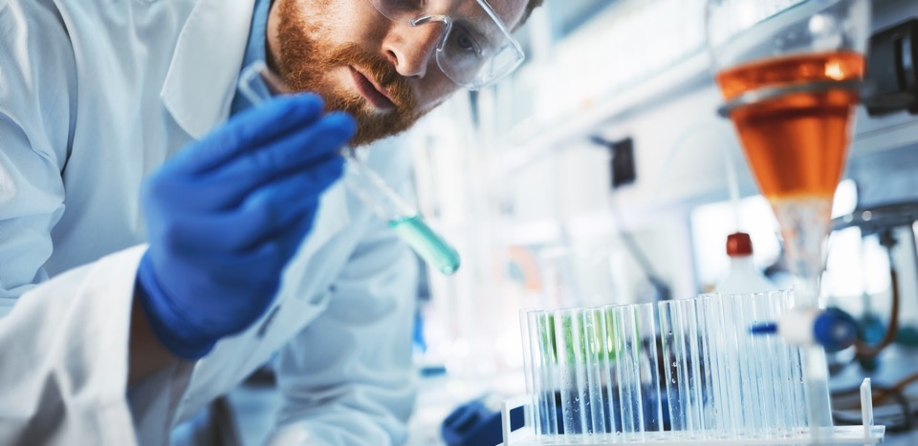

Market Share
Innovative chemical solutions for a cleaner, healthier, more energy efficient world

Slide 2
Surfactans for Personal and house Care

Slide 4
World consumption (11 381 thousands Mton)

Slide 5
World consumption 11 381 thousands Mton

Slide 7
Forecast

Slide 8
Surfactants Market in México Euromonitor Classification ( 629, 000 Mton in 2018)
Notes
Clasification from Euromonitor
Euromonitor only considers Personal and House Care

Slide 9
Surfactants Market in México, Stepan clasification ( 597, 000 Mton in 2018)
Notes
It is assumed all imported Lauric C12-14 becomes ethoxylated Alcohol and then to SLES
It is supposed imported AEM becomes SLES
It is assumed imported SLES 70% dilutes to SLES 28%
It is consider all imported LAB produces LABSA
It is considered imported DMAPA and ONAMINE 121416 becomes betaines and amine oxides

Slide 10
Notes
Mexico is the 5th consumer of surfactans globally 629, 000 Mton in 2018 ( after China, USA, India and Brazil); Colombia goes on 22nd place and Argentina 19th.
Mexico leads LATAM región (excluding Brazil)
The Trend is to import SLES 70%
Forecast is to increase from 629 000 Mtons (2018) to 683 000 Mtons (2023) 8% in Mexico

Slide 11
SLES

Slide 12
SLES 2018
Notes
It is assumed all imported Lauric alcohol becomes AE2 and then to SLES 28%
It is assumed all imported AE2 becomes SLES 28%
It is assumed all imported SLES 70% dilutes to SLES 28%
Stepan bought 2, 206 ton of lauric alcohol to Wilmar in 2018
30% of the market is from our customers (P&G, Colgate, Coty), they import SLES for its consumption

Slide 13
SLES 2018 (excluding Stepan’s customers)
Notes
It is considered stepan’s competitor and distribuitors
15,000 Mton from Wilmar are part of Stepan’s deliveries
In 2018 stepan delivered 33 200 mtons of SLES ( 18% of the market)

Slide 14
dodecyl benzene sulfonic acid

Slide 15
Sulfonic acid 2018
Notes
It is assumed all imported LAB becomes sulfonic acid
It was added the imported sulfonic acid
Almost 75% of the market is from our customers (la corona, P&G etc.), they import LAB for its consumption; only 25% of the market is from Stepan’s competitor. Stepan owns 1.5 % of this 25%

Slide 16
Sulfonic acid 2018 (excluding Stepan’s customers)
Notes
It is assumed all imported LAB becomes sulfonic acid
It was added the imported sulfonic acid
It is considered stepan’s competitor and distribuitors

Slide 17
Esterquats

Slide 18
Esterquat Market
(according to fabric softener local consumption and exports).
 | Ton
Mexico consumption 2018 | 724,270.60
Exports fabric softeners Mexico ton | 124,104.00
Total production fabric softener Mexico 2018 | 848,374.60
Sterquat Market Mexico | 63,628.10
Kao Mexico's exports (kaosoft and tetranyl) | 9,251.00
Total | 72,879.10
It is assumed the fabric softener contains 7.5% of sterquat

Slide 19
Esterquats
Notes
It is assumed all imported benzyl chloride, methyl cloride and dimethyk sulfate become an sterquat
Stepan buys benzyl chloride locally to Química Treza
Kao exports 9 251 tons of sterquats

Slide 20
Amphoterics (betaines and amine oxides)

Slide 21
Amphoterics (betaines and amine oxides)
Notes
It is assumed all imported DMAPA and Onamine 121416 become betaine or amine oxide
Stepan buys 660 Mtons of DMAPA locally from basf equivalent to 6 600 Mton of betaine
Stepan delivered 8 600 Mtons in 2018 ( 28% of the market)

Slide 22
Sources
Euromonitor
Panjiva
Pentatransation
Internal Anallysis

